Slide 1
PSCS_46_ Application for Assessment of Quality of Textbook/Reference Books/E-Book
CSE7101- Capstone Project
Review-2
Batch Number: CSE_169
Under the Supervision of,
Mr. Md Zia Ur Rahman
Professor
School of Computer Science and Engineering
Presidency University
Roll Number | Student Name
20221CSE0392 | LAVANYA M
20221CSE0266 | SUPRAJA POSINA
20221CSE0385 | CHETHANA T
Name of the Program: Computer Science and Engineering
Name of the HoD: Dr.Blessed Prince
Name of the Program Project Coordinator: Dr.Jayavadivel Ravi
Name of the School Project Coordinators: Dr. Sampath A K , Dr. Geetha A

Slide 2
Content
Abstract
Literature Survey
Objectives
Existing Methods and Drawbacks
Proposed Method & Feasibility Study
Architecture Diagram
Modules
Hardware and Software Details
Timeline (Gantt Chart)
References

Slide 3
Abstract
Concise overview:
Problem Introduction: Textbooks vary in quality, and there is no centralized system for students, reviewers, and committees to collaboratively evaluate them, leading to inconsistent learning outcomes.
Objective: To build a web-based platform that enables role-based review, rating, and approval of textbooks, with dashboards and analytics to support academic decision-making.
Approach: Using React, TypeScript, and TailwindCSS, the system provides login-based access for students, reviewers, and admins, stores reviews locally (extendable to databases), and visualizes results with interactive charts.

Slide 4
Literature Survey
Expert committee reviews are reliable but slow, costly, and sometimes subjective.
Student/teacher surveys capture classroom impact but suffer from bias and low participation.
Online ratings/marketplace reviews scale well but are prone to fake or non-expert inputs.
Publisher endorsements are quick but often commercially biased.
Automated methods (readability, plagiarism, NLP) provide scalability but fail to capture pedagogy and domain-specific accuracy.
Hybrid approaches combining expert evaluation, structured feedback, and analytics are recommended as the most effective solution.

Slide 5
Objectives
To develop a web-based platform for evaluating the quality of textbooks, reference books, and e-books.
To provide a standardized assessment framework with predefined quality parameters and weightages.
To enable secure reviewer authentication and role-based access control.
To automate the scoring and report generation process for quick decision-making.
To create a centralized database for storing book details, reviews, and historical records.
To ensure transparency, consistency, and efficiency in the evaluation process.

Slide 6
Existing Methods and Drawbacks
Expert committee reviews – Accurate but time-consuming, costly, and sometimes subjective.
Student/teacher surveys – Easy to collect but prone to bias and low response rates.
Online ratings (Amazon, portals) – Accessible but vulnerable to fake or non-expert reviews.
Publisher endorsements – Quick but often biased or commercially influenced.
Automated content checks (NLP, plagiarism, readability) – Scalable but miss conceptual depth and pedagogy.
Drawback summary: Existing methods are either slow and resource-intensive or fast but unreliable, lacking a balanced, transparent system for consistent textbook quality evaluation.

Slide 7
Proposed Method & Feasibility Study
Proposed Method:
Frontend: Developed using React, TypeScript, and TailwindCSS to provide a responsive and user-friendly interface.
Role-based Access: Students/reviewers submit ratings and comments, while admins/committees approve books and view analytics.
Data Storage: Implemented initially with localStorage for demonstration, but designed for extension to Express + MongoDB .
Analytics: Interactive dashboards using Recharts summarize subject-wise averages and overall textbook performance.
Feasibility:
Technical: Built with proven, lightweight, open-source tools.
Economic: Low cost; runs on standard hardware.
Scalable: Can extend to real databases and cloud deployment

Slide 8
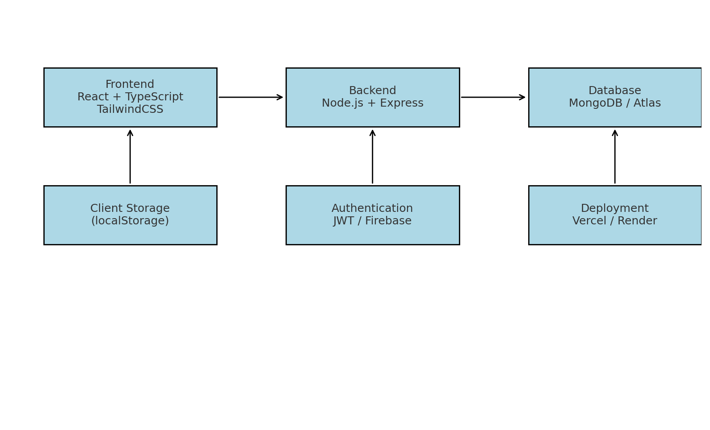
Architecture Diagram
Chatbot messenger

Slide 9
Modules
Authentication & Role Management:
Handles login and session storage.
Provides role-based access for Student, Reviewer, and Admin/Committee.
Book Management Module:
Displays textbooks with details (title, author, subject, rating).
Allows searching, filtering, and browsing books.
Review & Rating Module:
Students/Reviewers submit reviews with ratings and comments.
Stores and updates aggregated book scores.
Admin/Committee Module:
Approves or rejects books.
Monitors performance and ensures quality standards.
Analytics & Reporting Module:
Uses Recharts for visual dashboards.
Provides subject-wise averages and comparison charts.
Storage Module:
Uses localStorage (demo).
Can be extended to MongoDB for persistence.

Slide 10
Hardware and Software Details
Hardware:
Laptop/Server,
Internet.
Software:
Node.js & npm: Node 18.x LTS (or Node 20.x); npm bundled.
Check with: node -v and npm -v
Code editor: Visual Studio Code (recommended) or Notepad / Notepad++.
Git: for version control (git CLI).
Browser: Chrome, Firefox, Edge (latest stable) for testing.
Frame work: React(v18+) with TypeScript
Charts: Recharts

Slide 11
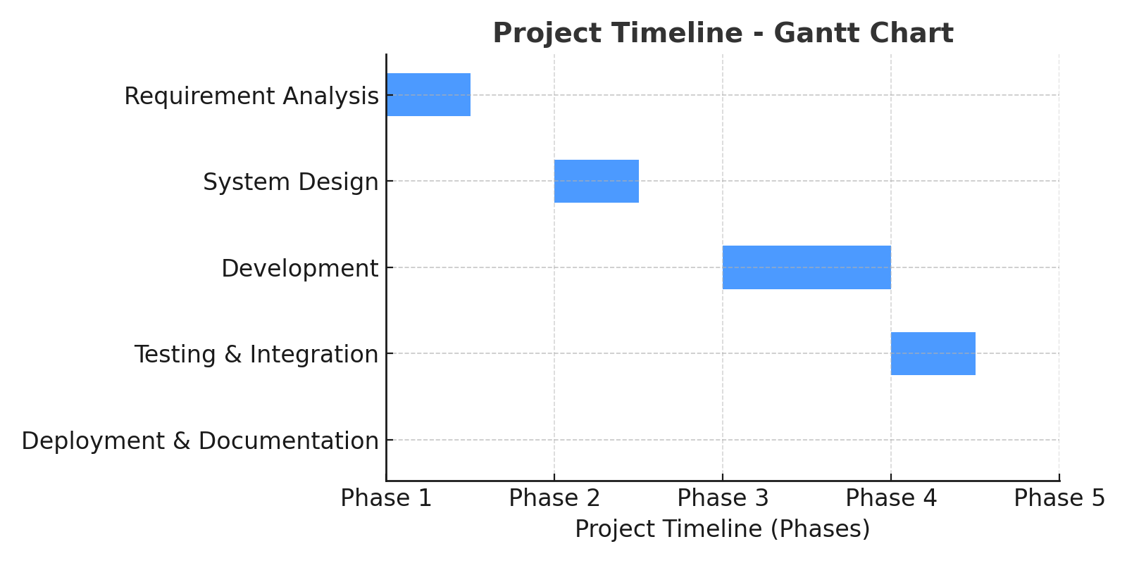
Timeline (Gantt Chart)

Slide 12
References(IEEE paper format)
[1] M. S. Al-Ajlan and M. A. Al-Khalifa, "Towards the development of an automated evaluation tool for digital educational resources," International Journal of Advanced Computer Science and Applications (IJACSA), vol. 7, no. 7, pp. 204–210, 2016.
[2] N. G. T. Izquierdo, L. A. G. Villalobos, and J. D. M. Ramírez, "A framework for the evaluation of e-learning materials," in Proc. IEEE Global Engineering Education Conf. (EDUCON), Abu Dhabi, UAE, 2016, pp. 1129–1134.
[3] R. K. Singh and A. Sharma, "Design and development of web-based evaluation system for academic resources," International Journal of Computer Applications, vol. 183, no. 8, pp. 25–30, June 2021.
[4] T. M. Connolly and E. A. Stansfield, "Evaluating the quality of learning resources: A web-based approach," in Proc. IEEE International Conf. on Advanced Learning Technologies (ICALT), Athens, Greece, 2014, pp. 37–41.
[5] M. A. Al-Emran, "Towards an intelligent framework for textbook evaluation in higher education," Education and Information Technologies, vol. 24, no. 2, pp. 1453–1468, Mar. 2019.
[6] S. R. K. Somasekhar, P. V. Kumar, and R. J. Reddy, "Automated assessment of educational content using multi-criteria analysis," in Proc. IEEE International Conf. on Technology for Education (T4E), Mumbai, India, 2020, pp. 215–220.

Slide 13
github link
https://github.com/Lavanya7004/Quality-Assesment-Capstone Project

Slide 14


